Slide 1
I KNEW
All New Online gaming platform
Yeon Jun Kim

Slide 2









Slide 3





Mission

Slide 4
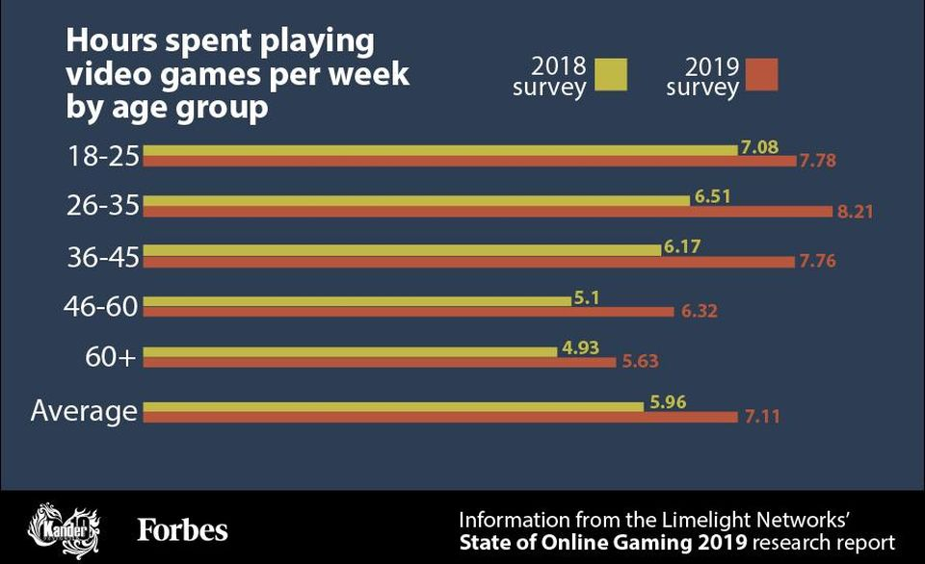

Target Users

Slide 5


Pandemic

Slide 6
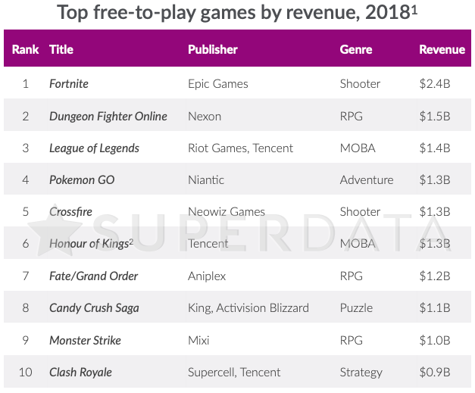

Strength

Slide 7
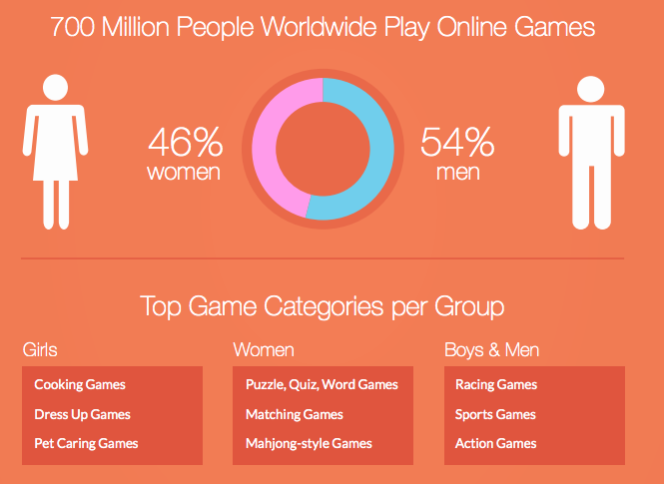

Strength

Slide 8


Weakness

Slide 9


Treats

Slide 10


Opportunities

Slide 11
5 year financial plan
Projected Financials |  |  | Year 1 | Year 2 | Year 3 | Year 4 | Year 5
 |  |  | $ | $ | $ | $ | $
Sales Revenue |  |  | $108,108.00 | $108,216.11 | $108,324.32 | $108,432.65 | $108,541.08
Cost of Sales
 | Direct Costs |  | $21,811.68 | $21,833.49 | $21,855.33 | $21,877.18 | $21,899.06
Gross Profit |  |  | ($4,348.38) | ($4,352.73) | ($4,357.08) | ($4,361.44) | ($4,365.80)
Selling and Administrative Expenses
 | Research and Development |  | $35,860.97 | $35,896.83 | $35,932.73 | $35,968.66 | $36,004.63
 | Advertising & marketing |  | $32,370.03 | $32,402.40 | $32,434.80 | $32,467.23 | $32,499.70
 | Distribution Expenses |  | $7,209.88 | $7,217.09 | $7,224.31 | $7,231.53 | $7,238.77
 | Salaries and Wages |  | $1,046.83 | $1,047.88 | $1,048.93 | $1,049.98 | $1,051.03
 | Operational Expenses |  | $1,449.46 | $1,450.91 | $1,452.36 | $1,453.81 | $1,455.27
Total Selling and Administrative Expenses |  |  | ($77,937.17) | ($78,015.11) | ($78,093.12) | ($78,171.21) | ($78,249.38)
Projected Income |  |  | $25,822.45 | $25,848.28 | $25,874.13 | $25,900.00 | $25,925.90

Slide 12
Expenditures Breakdowns
Research and Development
Advertising & marketing
Distribution Expenses
Salaries and Wages
Operational Expenses

Slide 13



Technological research and development

Slide 14


Totally NEW platform

Slide 15



Revenue Streams

Slide 16



Revenue Streams- continued

Slide 17
Organizational Structure
Founder
Technological managers
Finance Managers
Assistant
Managers
Marketing Managers
Technicians
Financial Assistants
Researchers
Staffs

Slide 18



ROI

Slide 19


Slide 20
Thank you
&
Invest me

